Slide 1



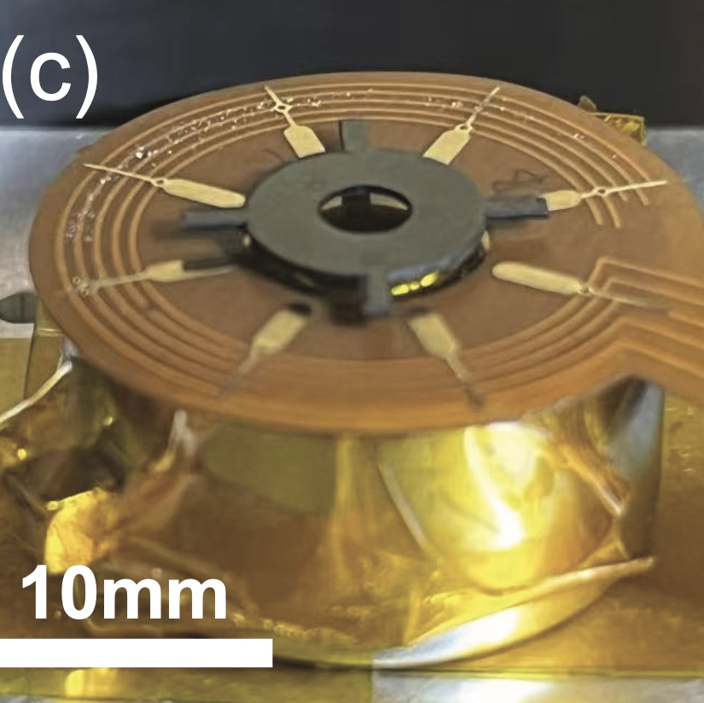

A*STAR
Physics-Informed Machine Learning
Presented by:
Priscilla Tay Tze Yee
July 2025

Slide 2






About Me
2nd-Year Undergraduate at Nanyang Technological University Singapore
Theoretical Physics Background
Transition to Machine Learning
Specialized in Quantum Field Theory
Discovered Physics-Informed Machine-Learning
Traditional pen-and-paper research approach
Opportunity to apply physics foundations to AI
Strength in exploring derivations from ﬁrst
First hands-on experience in programming for research
principles
Explored beautiful blend of fundamental physics
No prior experience in programming-intensive
with high level computing
machine learning research
Learning Approach
Took Coursera courses to attain a brief picture of important aspects of Neural Networks
2 / 21

Slide 3

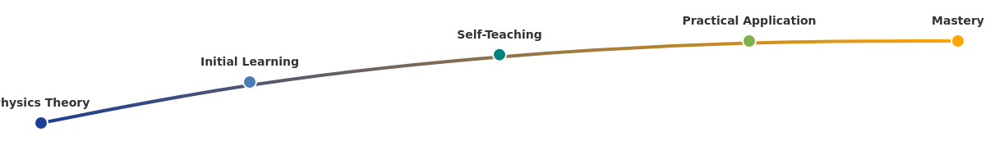



The Learning Curve
Theoretical Physics
Transition Phase
Applied Machine Learning
Quantum Field Theory background
First encounter with ML concepts
Physics-Informed Neural Networks
Pen-and-paper research approach
Self-learning through Coursera
Integrating physical principles
Strong theoretical foundation
courses
with ML
Limited computational experience
Adapting to independent research
Developing predictive models
Managing reduced supervisor
Growing computational expertise
involvement
Key Adaptations
Developed resourcefulness in problem-
Built interdisciplinary knowledge bridges
Learned to translate physics concepts into
solving
code
3 / 21

Slide 4



Physics-Informed Machine Learning: The Concept
The Challenge
In experiments, physical systems are subject to environmental randomness. Despite knowing ﬁrst principles, we lack the capacity to
identify subtle inconsistencies from the environment or minor discrepancies in the system itself.
Physics Domain
PIML Framework
Machine Learning
First principles & physical laws
Bridges physics & data-driven
Pattern recognition & feature
approaches
learning
Purpose
Beneﬁts
Automate the detection of subtle hidden physics in
AI assists experimentalists in studying signiﬁcant and yet
experimental systems across all experimental runs.
unapparent details in system designs, enabling necessary
alterations when engineering the system.
4 / 21

Slide 5




Project Overview: Ultra-Fast Spinning Rotor
Collaboration with experimentalists to develop the world's fastest spinning levitating rotor for
hypersensitive environmental detection.
Collaboration
Device Design
Working with engineers & experimentalists
4 arms and 6 electrodes conﬁguration
Combining theoretical physics with experimental data
Levitation on a surface generating magnetic ﬁelds
Iterative research approach with experimental validation
Electrostatic forces from arm-electrode overlap
Applications
Technical Challenge
Ultra-sensitive environmental detection
Wobbling behavior at high speeds (500 RMP). Decay in rotational velocities.
Gyroscopes with improved detection capabilities
Three axes of rigid body modes discovered
High-precision rotational sensing systems
Investigating missing physics through PIML approach
Our goal: Use PIML to identify missing physics and improve the performance of the ultra-fast spinning rotor.
5 / 21

Slide 6

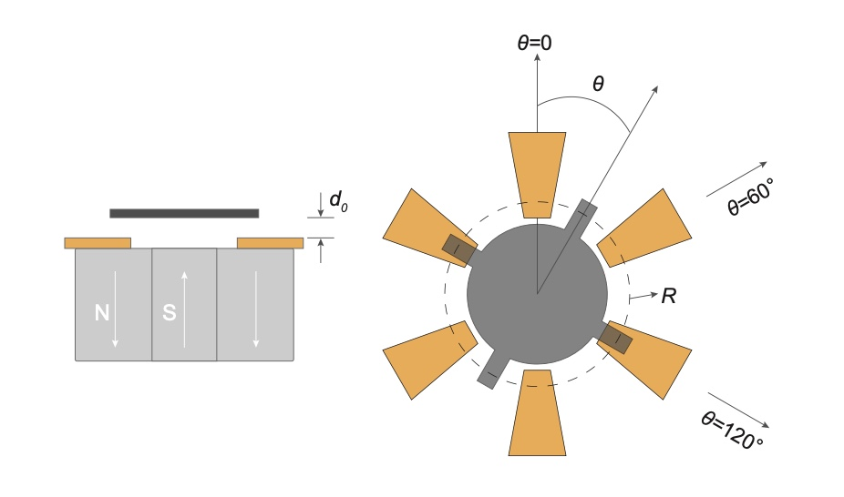

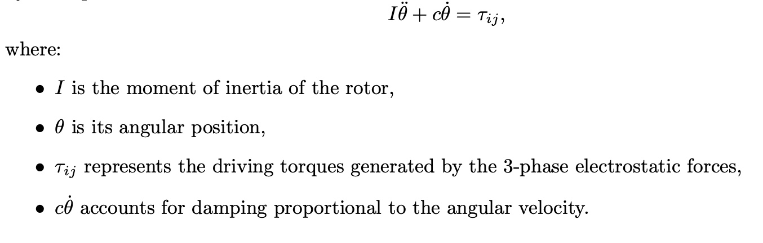

The Physical System
System Components
Rotor System Visualization
Rotator with 4 arms
Surrounding 6 electrodes
Levitation on a magnetic ﬁeld generating surface
Electrostatic Force Generation
Overlapping areas between arms and electrodes
Electrostatic forces generated at these interfaces
Torque Generation
Electrostatic forces create rotational imbalance
Leads to torque on the system
6 / 21

Slide 7
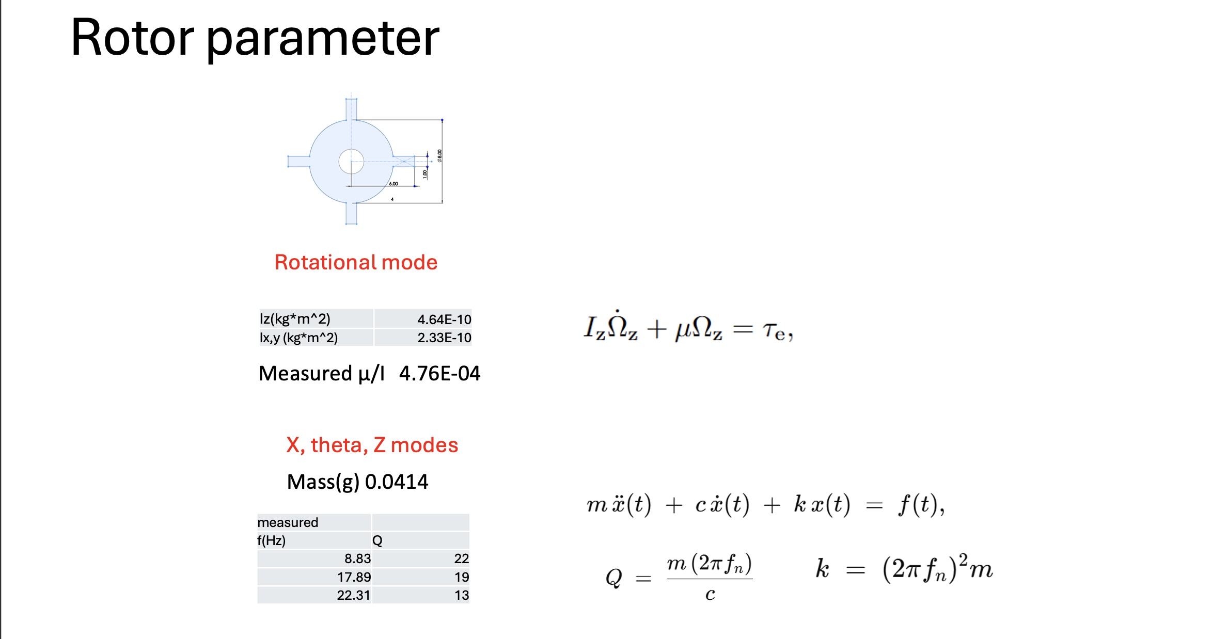
The Physical System

Slide 8
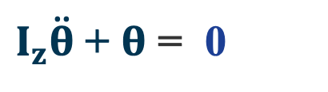
Primary Equation of Motion
The ﬁrst principal equation governing the rotor's rotation about the central vertical axis:
̇
$I_{z}\ddot{θ}$+ $θ$ = 0
I
θ
θ
̇
z
Moment of inertia about the vertical z axis
Angular position of the rotor about the
Angular velocity of the rotor's rotation
of the rotor system
central vertical axis
about the z axis
Key Insight
Setting torque (τ) equal to zero on the right side of the equation simpliﬁes the analysis to focus on the natural dynamics of the system.
This is particularly relevant when investigating the wobbling behavior at high speeds.
7 / 21

Slide 9

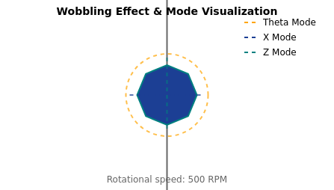
The Challenge: Wobbling at High Speeds
The Wobble Eﬀect
Three Axes of Rigid Body Modes
At 500 RPM, the rotor begins to wobble dramatically
During experimental runs, three distinct axes of vibration were identiﬁed:
This wobbling indicates a loss of stability in the
system
Theta Mode
X Mode
Z Mode
Experimentalists discovered this threshold through
Rotational vibration
Horizontal vibration in
Vertical vibration along
careful observation
around the central
the plane of rotation
the axis of rotation
The collaborators want to understand why this
vertical axis
happens
Resonance & Energy Transfer
When rotational frequency matches a mode's natural frequency, resonance
occurs
In experimentalists' data, larger vibrational amplitudes appear at resonance
Collaborators suspect coupling generates a driving force on the rotating rotor
This driving force could cause energy transfer from rotation to the vibrational
modes
Visualization of the wobbling eﬀect at 500 RPM
8 / 21

Slide 10
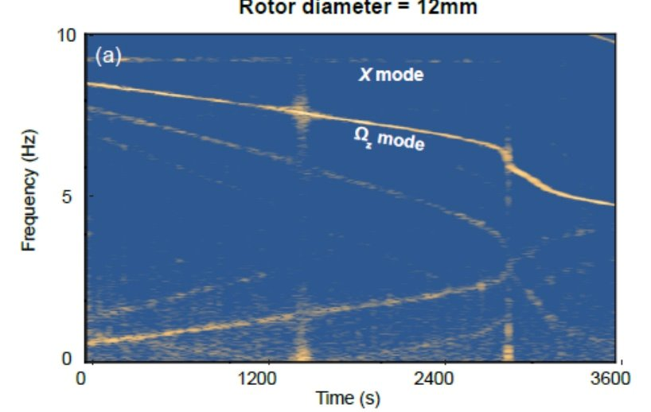
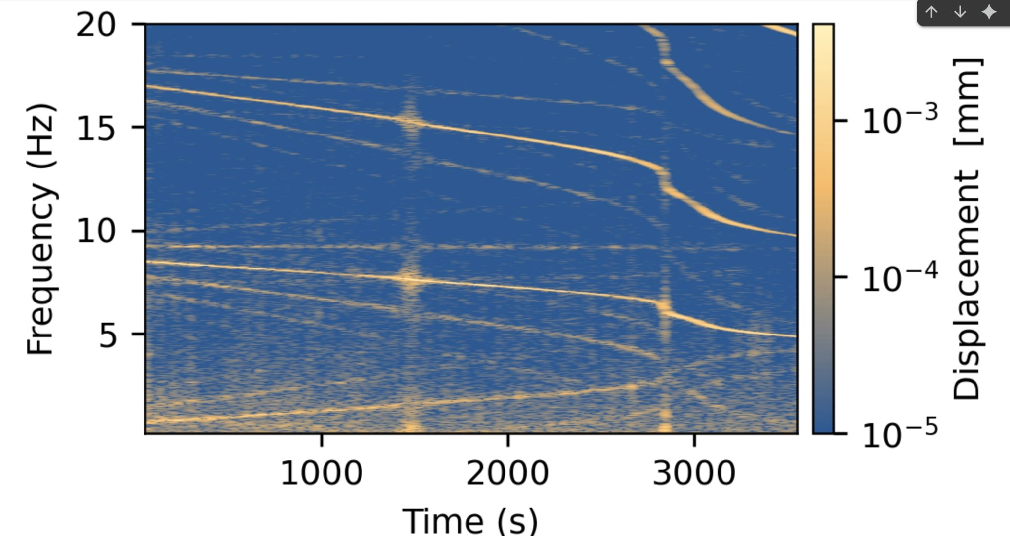
Mode Coupling & Resonance Eﬀects
Frequency-Amplitude Relationship
Key Observations
At 500 RMP, rotor exhibits dramatic wobbling
Three rigid body modes identiﬁed: Theta, X, and Z
Resonance occurs when rotational frequency
matches mode's natural frequency
Energy Transfer Mechanism
Coupling between rotation and vibration modes creates
a driving force that transfers energy from rotation to
vibrational modes, causing the system to ringdown.
PIML identiﬁes coupling between these modes
9 / 21

Slide 11
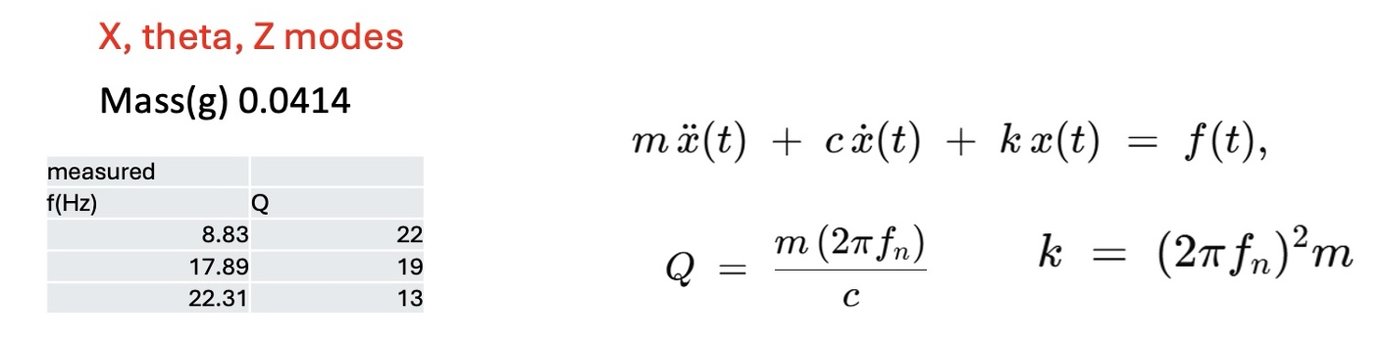




Secondary Equation: Mode Vibration
The second equation describes a second order diﬀerential equation that relates the amplitudes of mode vibrations
to the coupled driving force.
i
i
i
Mode Amplitudes
Coupled System
Driving Force
Describes the vibration amplitudes of the
Models the energy transfers between the
The collaborators suspect this force is
three rigid body modes (Theta, X, and Z)
rotating system and the vibrational modes
generated by coupling between the
discovered during experimental runs.
through coupling eﬀects.
modes and the rotating system, causing
energy transfer.
Project Goal: Use PINNs to identify the function of this presumed coupled driving force to investigate its precise generation
mechanism.
10 / 21

Slide 12


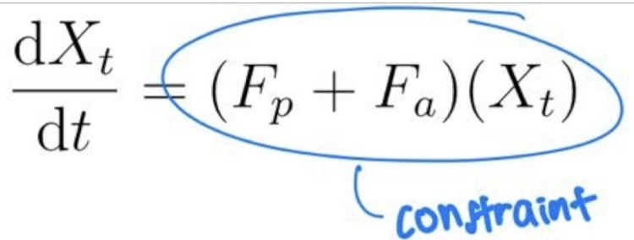
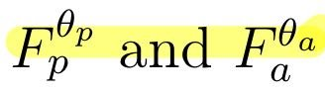
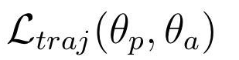
The APHYNITY Model
A machine learning approach that decomposes physical dynamics into two key components:
Physical Component (F )
Data-Driven Component (F )
p
a
Derived from prior knowledge of ﬁrst principles
Learns from experimental data
Represents the known physics of the system
Discovers errors in the physical model
Includes the equation of motion for the rotor
Identiﬁes missing physics equations
Combines
·
̈
Training Process
Parameters θ
Lagrangian
Loss Function
Variables of the Lagrangian which is considered the weights of the Neural Network
Mean squared errors between prediction and data
11 / 21

Slide 13






Project Roadmap: Six Key Steps
A multi-stage approach designed to build toward analyzing experimental data with Physics-Informed Neural Networks
Step 1
Step 2
Step 3
Script Conversion to JAX
Neural Network for Torque
ODE Solver Integration
Convert Numpy script containing
Prediction
Insert second equation into Numpy ODE
equations of motion and numerical
Develop a neural network that predicts
numerical solver and ensure correct
solver to JAX framework
the torque of the rotor system based on
conversion to JAX framework
simulated data
Step 4
Step 5
Step 6
Physics-Informed Prediction
Coupled Driving Force
Experimental Data Analysis
Use physics-informed approach to
Repeat procedure after adding ﬁrst equation of
Obtain actual experimental data from
predict the driving force on the system
Motion. Now the constructed
collaborators and use it with the
driving force is a function of both mode position
and angular position.
developed Neural Network.
Goal: Identify missing physics equations based on experimental data
13 / 21

Slide 14

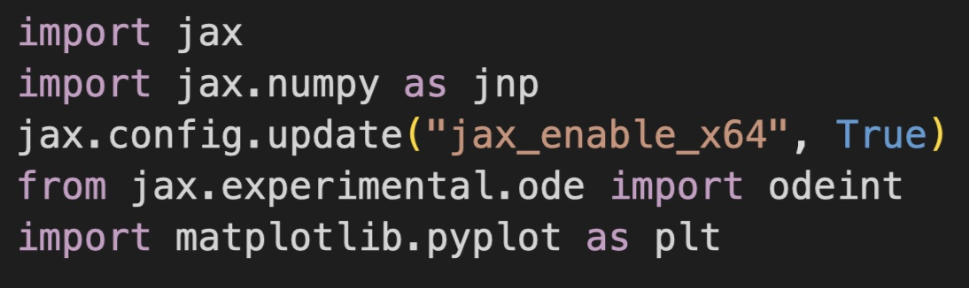
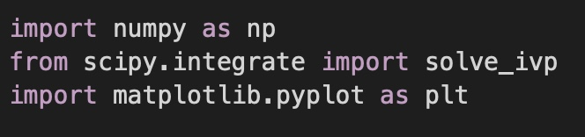
Step 1: Script Conversion to JAX
Convert the Numpy script to JAX for high-performance computing.
Original Numpy Script
JAX Framework
Equations of motion
High-performance computing
ODE solver
Auto-diﬀerentiation
Simulation data generation
GPU/TPU support
Key Conversion Challenges
Array Operations
Numerical Solvers
Code Structure
Convert Numpy arrays to JAX arrays
Adjust ODE solver for JAX compatibility
Reorganize for JAX's functional style
14 / 21

Slide 15




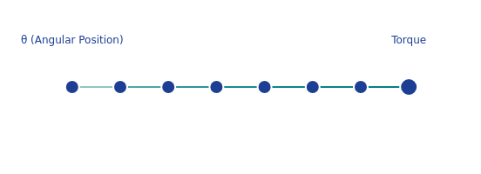
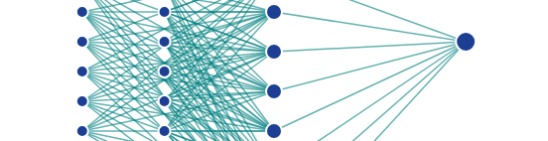


Step 2: Neural Network for Torque Prediction
Practice Task
Developing a neural network to predict rotor system torque to learn how to create accurate physics predictions
1-Dimensional Neural Network
2-Dimensional Neural Network
Single variable prediction
Multi-variable prediction
Predicts torque based on angular position (θ)
Predicts torque based on angular position (θ) and frequency
Simple architecture focusing on rotational dynamics
(f)
Validates basic neural network implementation
Additional input dimension captures rotational kinematics
More comprehensive model of system dynamics
$$θ, f$$
Torque
Key Insight
This practice task established the foundation for developing neural networks that can accurately identify missing physics equations in the
system
15 / 21

Slide 16

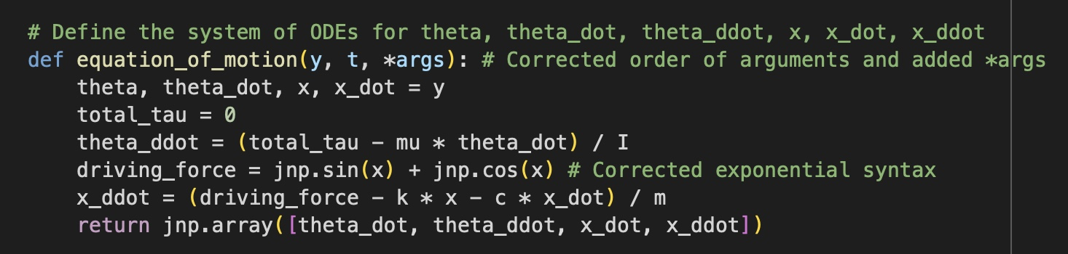
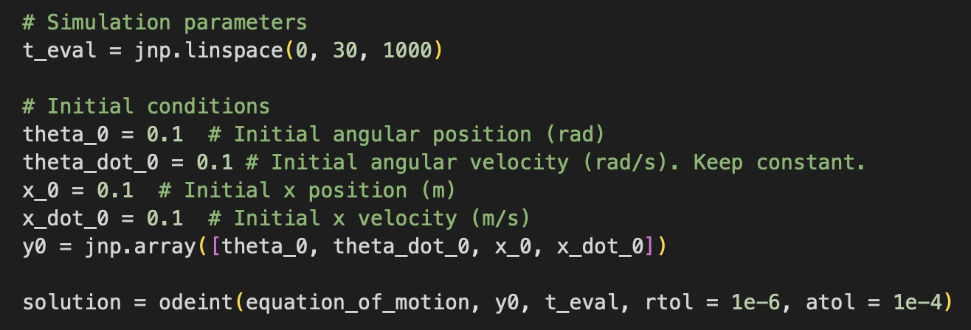
Step 3: ODE Solver Integration
Inserting the second equation into the ODE numerical solver and ensuring correct conversion to the JAX framework.
JAX Implementation
Integration Result
solve_ivp
Implementation Challenges
Solutions Implemented
Converting from Numpy to JAX framework
Replaced Numpy with JAX functions
Adjusting numerical solver parameters
Modiﬁed solver tolerance parameters
Identifying subtle code adjustments needed
Validated against original Numpy data
16 / 21

Slide 17






Step 4: Physics-Informed Prediction Approach
Current Work Focus
Physics-Informed Approach
Predicting the driving force on the system
Using physics equations as constraints
Driving force produced by coupling between modes and
Training data from ODE solver solutions
system rotation
Predicting driving force from mode position/velocity
Assuming form of driving force is known (function of mode
Validating against experimental observations
position)
Training NN based on solutions to diﬀerential equations
Physics-Informed Prediction Process
Equation Formulation
ODE Integration
NN Training
Validation
Deﬁne equations with
Solve equations of motion
Conﬁgure functions to
Compare predictions with
assumed driving force
with ODE solver
represent missing physics
experimental data
Current Challenge: Balancing between physics constraints and data-driven learning to accurately predict the driving force
17 / 21

Slide 18



Steps 5 & 6: Future Work
After completing the current physics-informed prediction approach, the project will advance to incorporate more realistic driving
force models and apply them to actual experimental data.
4
5
6
Current Step
Future Step
Final Step
Step 5: Complex Driving Force
Step 6: Application to
Model
Experimental Data
Re-introduce the ﬁrst equation of motion governing rotation
Obtain actual experimental data from collaborators
Construct driving force as function of both angular position
Process data containing mode position, mode velocity,
and mode position
angular position, and angular velocity over time
Account for coupling between modes and rotating system
Apply ODE numerical solver to make predictions
Train NN to predict the more realistic driving force
Validate model predictions against experimental
observations
This step represents a more realistic modeling approach compared
to the current work.
This ﬁnal step represents the practical application of the
developed model to real-world experimental data.
18 / 21

Slide 19


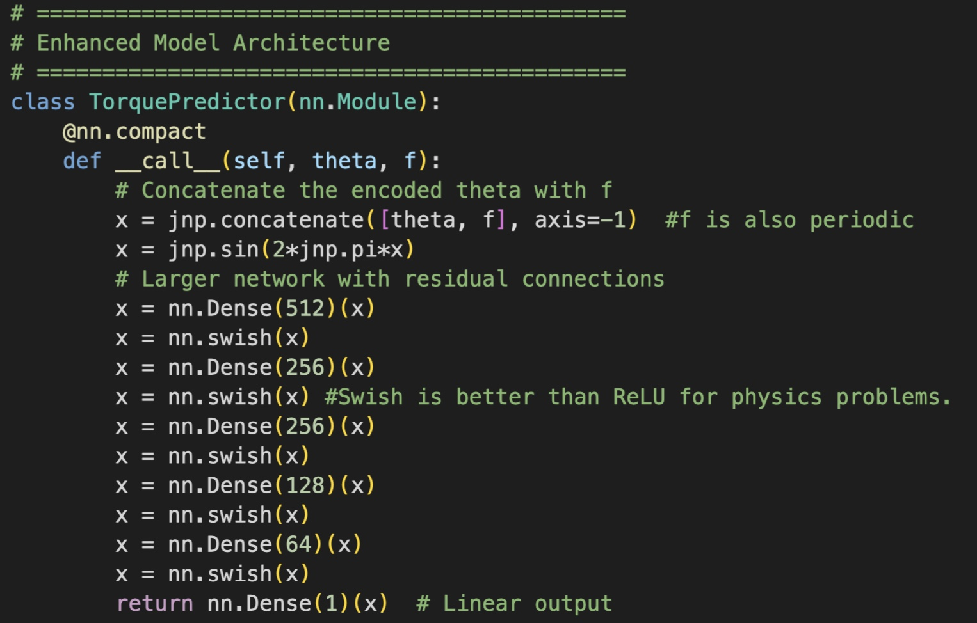

Neural Network Structure
Network Architecture
Network Components
Input Layer: Receives theta and frequency values
Hidden Layers: Learn features of input data
Output Layer: Produces torque predictions
Parameters: Weights and biases updated during training
Training Process
Input Layer
Hidden Layers
Loss Function: Mean squared errors between predictions and
Output Layer
actual values
Gradients: Direction of steepest ascent of loss function
Gradient Descent: Taking negative of gradients for optimization
Learning Rate: Controls the size of weight updates
Torque Prediction
Data Pipeline
Theta & Frequency
Feature Learning
Simulation: Generate data using equations of motion
Training: Update parameters to minimize errors
Testing: Validate performance on unseen data
19 / 21

Slide 20
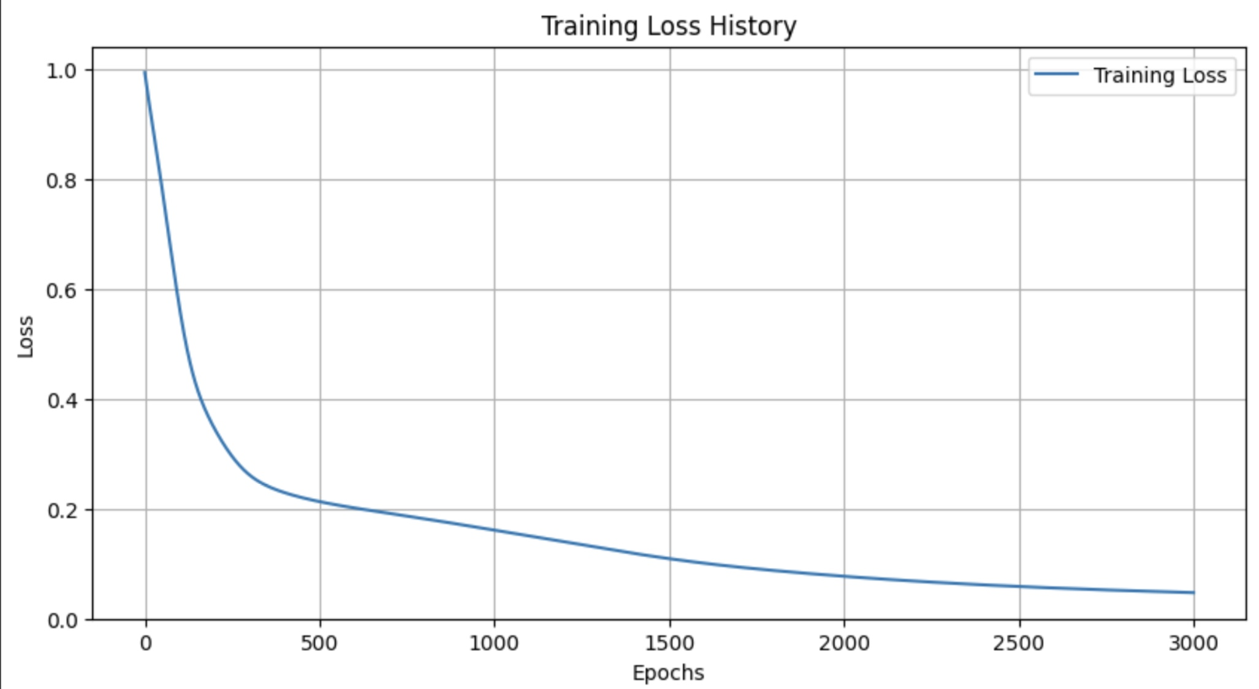
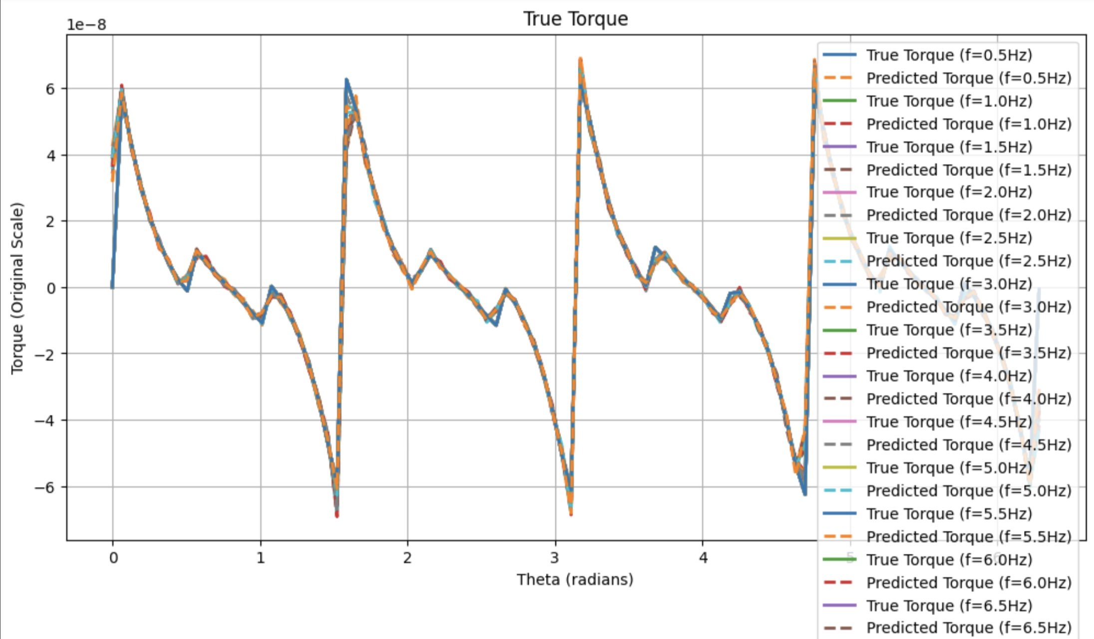
Neural Network Structure (Example of an accurate prediction of Torque)

Slide 21


Challenges & Adaptations
Technical Challenges
Personal Adaptations
Complex NN Structures
Time Pressure
Took 3 weeks to resolve major issues with programming
Last 2 weeks faced intense pressure to deliver completed
scripts and complex neural network structures
tasks for final deployment.
Script Conversion
Expectation Management
Diﬃculties converting from Numpy to JAX framework due to
Learned to balance expectations on delivery
ﬁne adjustments in the ODE solver
Solution: Seek Help
Mindset Adjustment
Worked through the structure again with a more experienced
Developed resilience by focusing on what I could control
colleague to attain comprehensive understanding
rather than engaging in self-doubt for delays
"The kind of compromise to make when facing technical limitations while maintaining scientiﬁc integrity."
20 / 21

Slide 22


Key Takeaways
What I learned during machine learning journey
Programming Skills
Work Discipline
Gained experience with JAX framework and complex neural
Developed better discipline in managing hybrid work
networks. Learned to handle programming scripts
setup. Learned to balance independent research with
eﬃciently.
meeting targets.
Independent Learning
Resourcefulness
Built conﬁdence in picking up new skills and knowledge
Learned to adapt and ﬁnd creative solutions with limited
independently. Developed intuition for problem-solving.
guidance. Collaborated eﬀectively with more experienced
scientists and engineers.
Final Reﬂection
This journey has transformed my approach to research and problem-solving. I'm grateful for the opportunity to bridge theoretical
physics with cutting-edge machine learning techniques.
21 / 21
Thank you!

